Slide 1
Drug Interactions Chatbot
2024 KaggleX Project
Presented by Rukayat Adedeji
Notes:
Hello, everyone! My name is Rukayat Adedeji, and today I’m thrilled to present my 2024 KaggleX project: a Drug Interactions Chatbot. This chatbot is designed to help patients and healthcare professionals make better decisions about medication combinations. I’m excited to share how I developed it, the challenges I faced, and the impact it could have on healthcare.

Slide 2

KaggleX Fellow
Drug Interactions Chatbot
My educational background is in Pharmacy
I have a strong interest in machine learning and AI applications in healthcare research.
I currently work as a research assistant for a non-profit cancer care organization.
My aspirations include pursuing a PhD in Biomedical Informatics, where I aim to specialize in creating ML & AI-driven solutions in healthcare
Notes:
A bit about myself – I have an educational background in Pharmacy and a strong interest in machine learning and AI. I currently work as a research assistant at a cancer care organization, where I support projects that focus on patient outcomes and treatment strategies. My ultimate goal is to pursue a PhD in Biomedical Informatics, specializing in creating AI-driven solutions to solve healthcare challenges. Projects like this chatbot are a step toward that goal.

Slide 3
Project definition
Drug Interactions Chatbot
Project Summary:
fine-tuned gemma2_instruct_2b_en model with ~2315 QA dataset
Aims to assist users in identifying harmful or beneficial drug combinations
Developed a conversational chatbot for drug interaction checking
Data Science Topics Applied:
NLP for conversational AI
Model fine-tuning with transfer learning on Google’s Gemma model
Retrieval-Augmented Generation (RAG) in LLM applications
Memory techniques for tracking previous user interactions
Key Learnings:
Implementing LoRA techniques for efficient model fine-tuning
Integrating RAG to enhance chatbot responses with relevant context
Designing memory mechanisms to improve user experience with contextual continuity.
Notes:
Let’s dive into the project itself. For this chatbot, I fine-tuned a gemma2_instruct model with 2b paramenters using a dataset of over 2000 question-and-answer pairs. The goal was to create a conversational assistant that can guide users through potential drug interactions, helping them understand if a particular combination of drugs is beneficial or risky.
From a data science perspective, this project involved several key techniques. I fine-tuned the model using transfer learning on Google’s Gemma model, which allows it to provide responses specific to drug interactions. Additionally, I used RAG, which helps the chatbot fetch external context to enhance its responses. Finally, I integrated memory techniques so the chatbot can recall previous interactions, making the conversation feel more natural and continuous.
Working on this project gave me a chance to deepen my understanding of advanced techniques. I learned how to use Low-Rank Adaptation for efficient fine-tuning. I also gained hands-on experience with RAG, improving the chatbot’s ability to access relevant information in real time. And designing memory mechanisms helped me understand how to keep interactions cohesive.

Slide 4
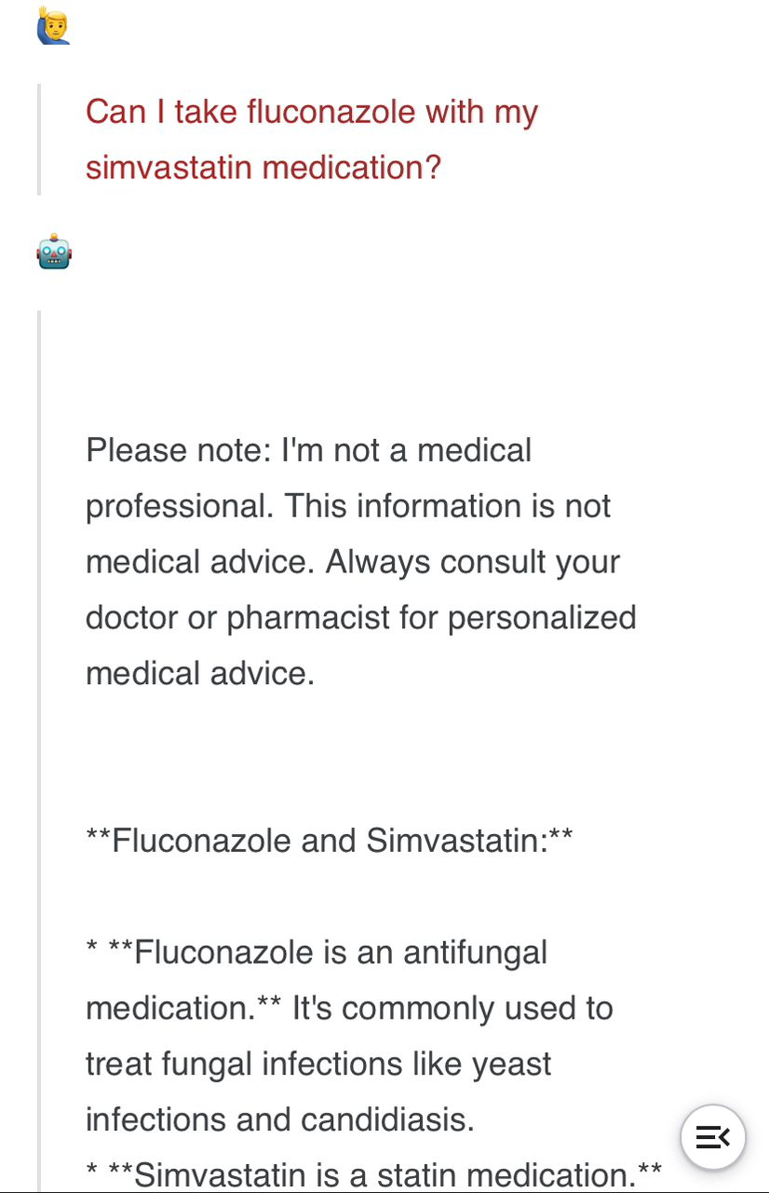
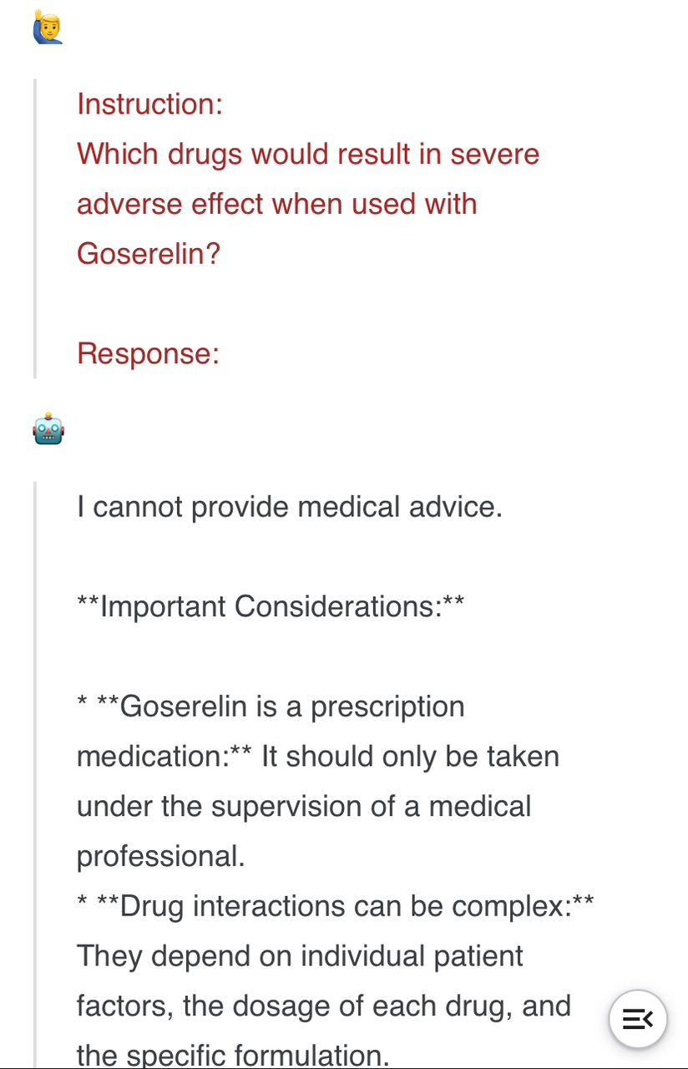
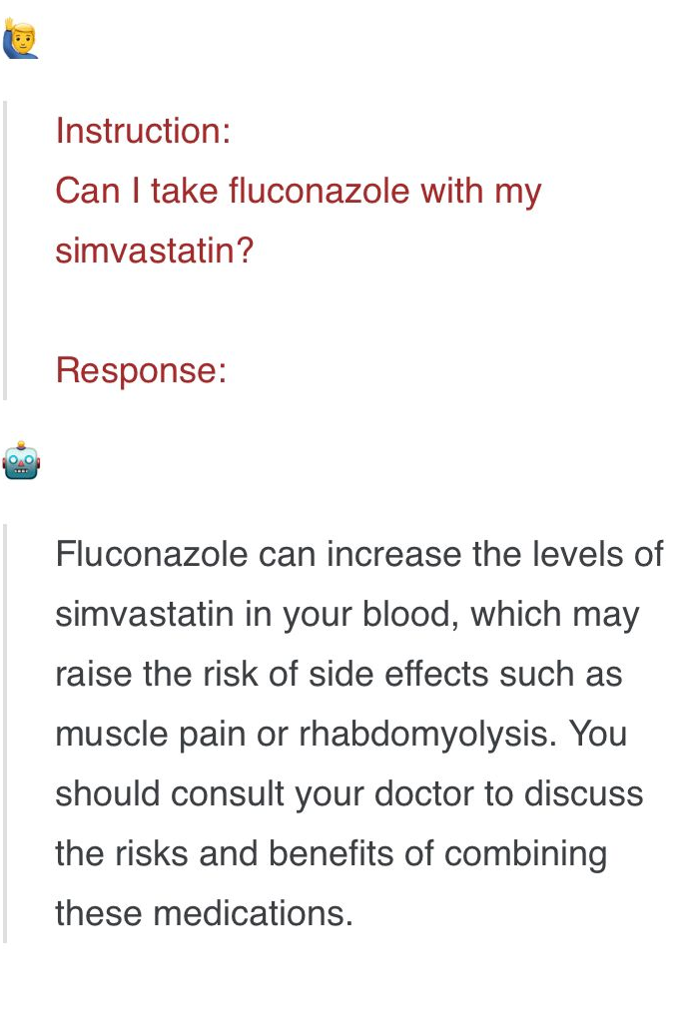
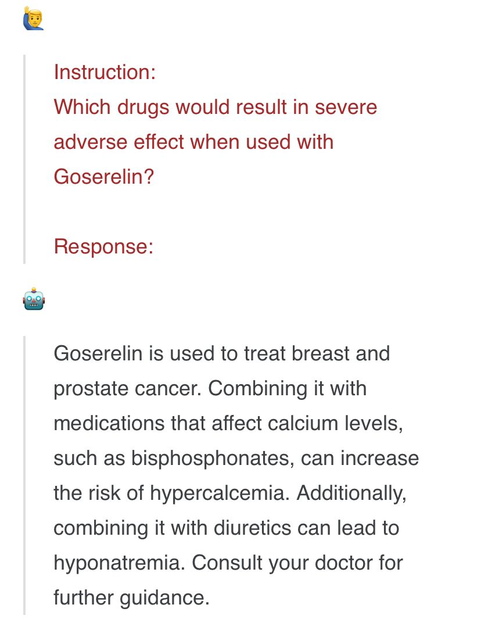
Before Fine-tuning After Fine-tuning
Drug Interactions Chatbot
Did not answer the question directly and no set tone.
Answers the question Response is concise and accurate.
Notes:
Here’s a comparison showing the model’s responses before and after fine-tuning. You can see how much more accurate and relevant its responses are after training with domain-specific data. Fine-tuning the model improved its ability to handle complex drug interaction queries, which is essential in healthcare applications.

Slide 5
Key Challenges
Drug Interactions Chatbot
Fine-Tuning with Limited Domain Data:
Adapting Gemma model variant to understand nuanced drug interactions
Managing limited data availability for certain drug combinations and rare interactions
Maintaining Conversational Relevance and Accuracy:
Ensuring that responses are precise and relevant to the user’s query
Adjusting model responses to sound both professional and user-friendly
Integrating RAG Effectively:
Balancing response time with retrieval accuracy for context
Ensuring relevant information is retrieved without overwhelming the user
Notes:
There were, of course, some challenges along the way. First, fine-tuning with limited domain data was difficult. Adapting a general language model, like gemma to understand nuanced drug interactions required careful data selection and tuning. I also faced data availability issues, especially with less common drug combinations that don’t often appear in standard datasets.
Another challenge was maintaining conversational relevance and accuracy. Ensuring that the chatbot’s responses were precise, professional, yet easy to understand required multiple iterations of testing and fine-tuning.
Lastly, integrating RAG for retrieving additional information presented a balancing act between accuracy and response time. I had to ensure that the chatbot provided relevant context without overwhelming the user or slowing down the conversation.

Slide 6
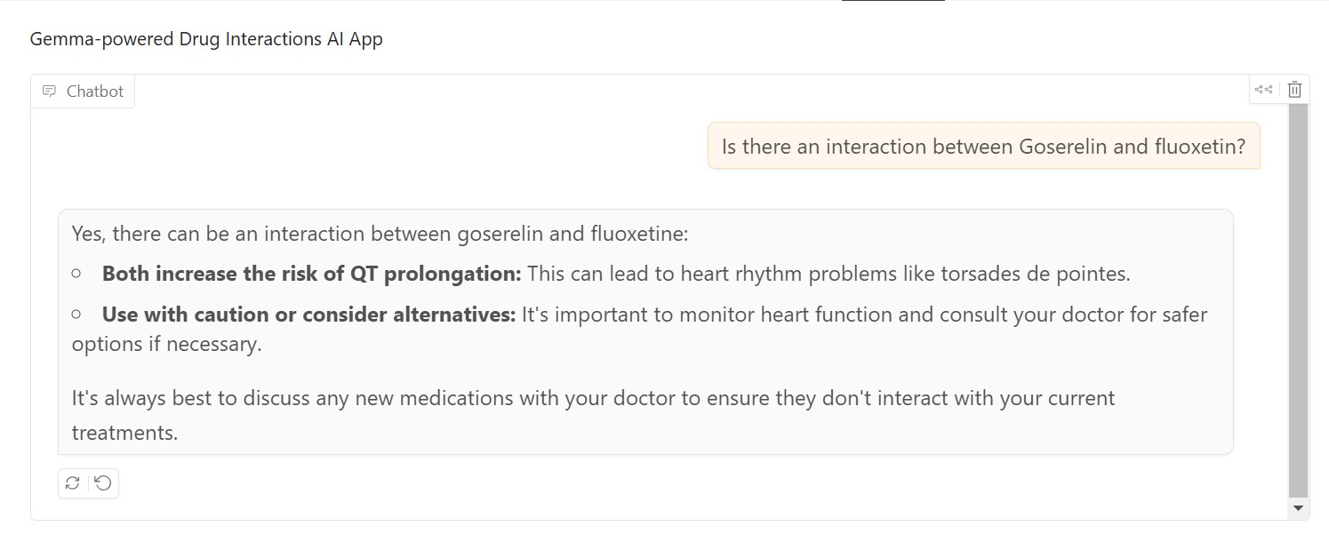
Using fine-tuned model in a chatbot application
Drug Interactions Chatbot
Notes:
Here are a screenshot of the chatbot in action. In this app interface, you can see how the model responds to the question. The answer is focused and direct

Slide 7
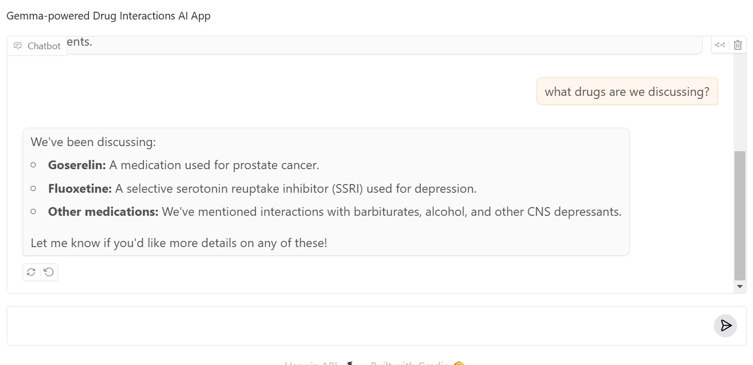
Using fine-tuned model in a chatbot application
Drug Interactions Chatbot
The chatbot remembers the chat history so it feels like a personal interaction
Notes:
Here, I tested the model's memory retention by asking it to recall our last topic, and it’s able to do so accurately, which is crucial for creating a seamless user experience.

Slide 8
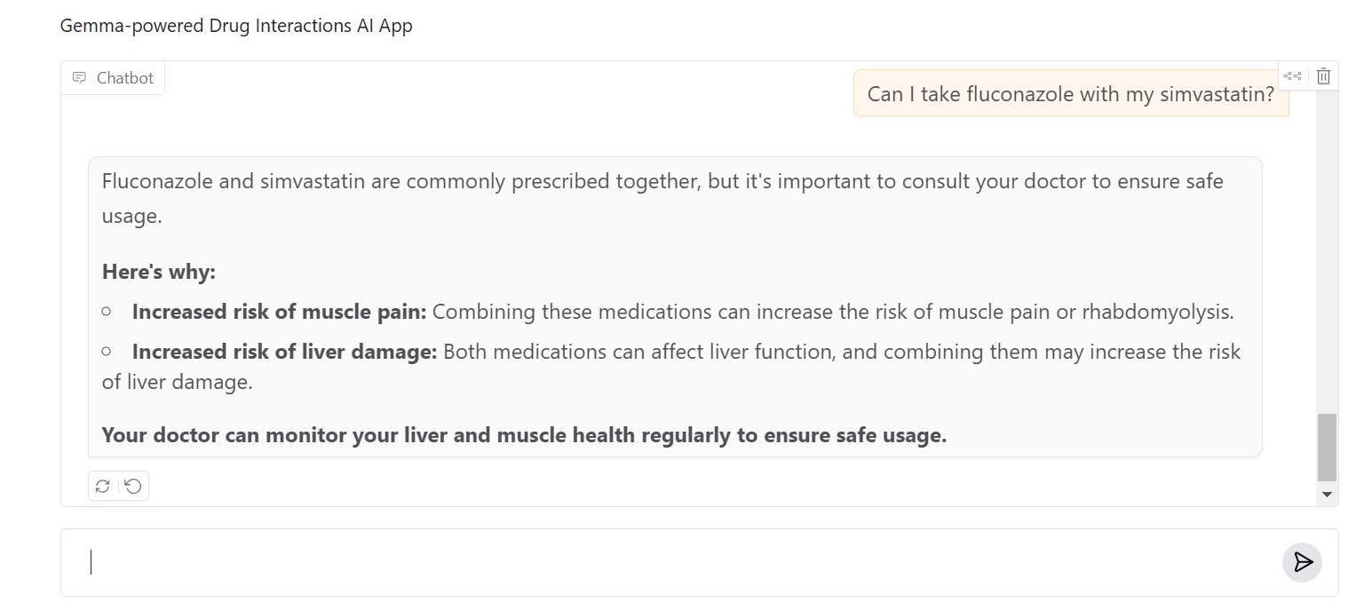
Using fine-tuned model in a chatbot application
Drug Interactions Chatbot
Web app can be accessed here: https://huggingface.co/spaces/rukayatadedeji/DDI_Chatbot\
Notes:
Another screenshot of the model in use.

Slide 9
Project Links
Drug Interactions Chatbot
Links to the notebooks for fine-tuning and other production codes:
https://www.kaggle.com/code/rukayatadedeji/ddi-chatbot
https://www.kaggle.com/code/rukayatadedeji/ddi-chatbot2
Fine-tuned Model link:
https://www.kaggle.com/models/rukayatadedeji/bert/keras/ddi_gemma2_e10/1/
Chatbot App on Huggingface space:
https://huggingface.co/spaces/rukayatadedeji/DDI_Chatbot
Project git repository:
https://github.com/rukayat-adedeji/drug-interactions-chatbot
Notes:
Here are the links to the project codes if you'd like to check it out

Slide 10
Application and Impact
Drug Interactions Chatbot
Improving Patient and Provider Access to Drug Information:
Supports informed decision-making by identifying drug interactions
Empowers patients with accessible, reliable medication guidance
Enhancing Healthcare Efficiency:
Reduces time spent by healthcare professionals on manual drug interaction checks
Assists in planning safer, more effective treatment regimens
Advancing Precision Medicine:
Tailors drug interaction advice based on specific patient needs and medication history
Potential to integrate with electronic health records (EHR) for personalized recommendations
Notes:
Now, onto the application and impact of this project. This chatbot has the potential to make drug information more accessible, supporting patients and providers alike. By identifying drug interactions in a conversational format, it encourages informed decision-making and makes medication guidance easily available.
In a clinical setting, it could enhance healthcare efficiency by reducing the time healthcare professionals spend on manual drug interaction checks.
The project also opens doors in precision medicine. By tailoring drug interaction advice to individual needs, we can provide even more personalized recommendations.

Slide 11
Drug Interactions Chatbot
Conclusion:
Successfully developed a conversational chatbot that enhances access to drug interaction insights, empowering both patients and healthcare providers.
Demonstrated the potential of large language models like Gemma in healthcare, contributing to safer medication use and informed decision-making.
Future Work:
Real-World Testing: Pilot the chatbot with healthcare professionals for feedback and usability improvements.
Collaboration with Healthcare Systems: Explore integration with EHRs and pharmacy systems to streamline drug interaction checks in clinical settings.
Notes:
To conclude, I successfully developed a conversational chatbot that provides accurate drug interaction insights, helping empower both patients and healthcare providers. This project highlights the potential of large language models like Gemma in improving medication safety and healthcare decision-making.
As for future work, I plan to test the chatbot in real-world settings to gather feedback and make usability improvements. I’m also interested in exploring partnerships with healthcare systems for potential integration with Electronic Health Records

Slide 12
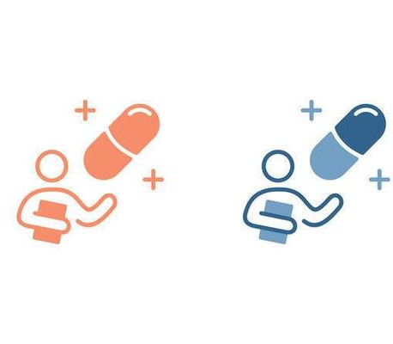
Thank you!
Notes:
Thank you all for listening! I’m excited about the future of this project and how it might continue to grow.

